Slide 1

Chapter 1
Introduction to Computing Science in Science Education
Computing Science for Science Teaching
วิทยาการคำนวณสำหรับการสอนวิทยาศาสตร์
CHEWA THASSANA
Center for AI Powered Digital AgriPhysics Research

Slide 2

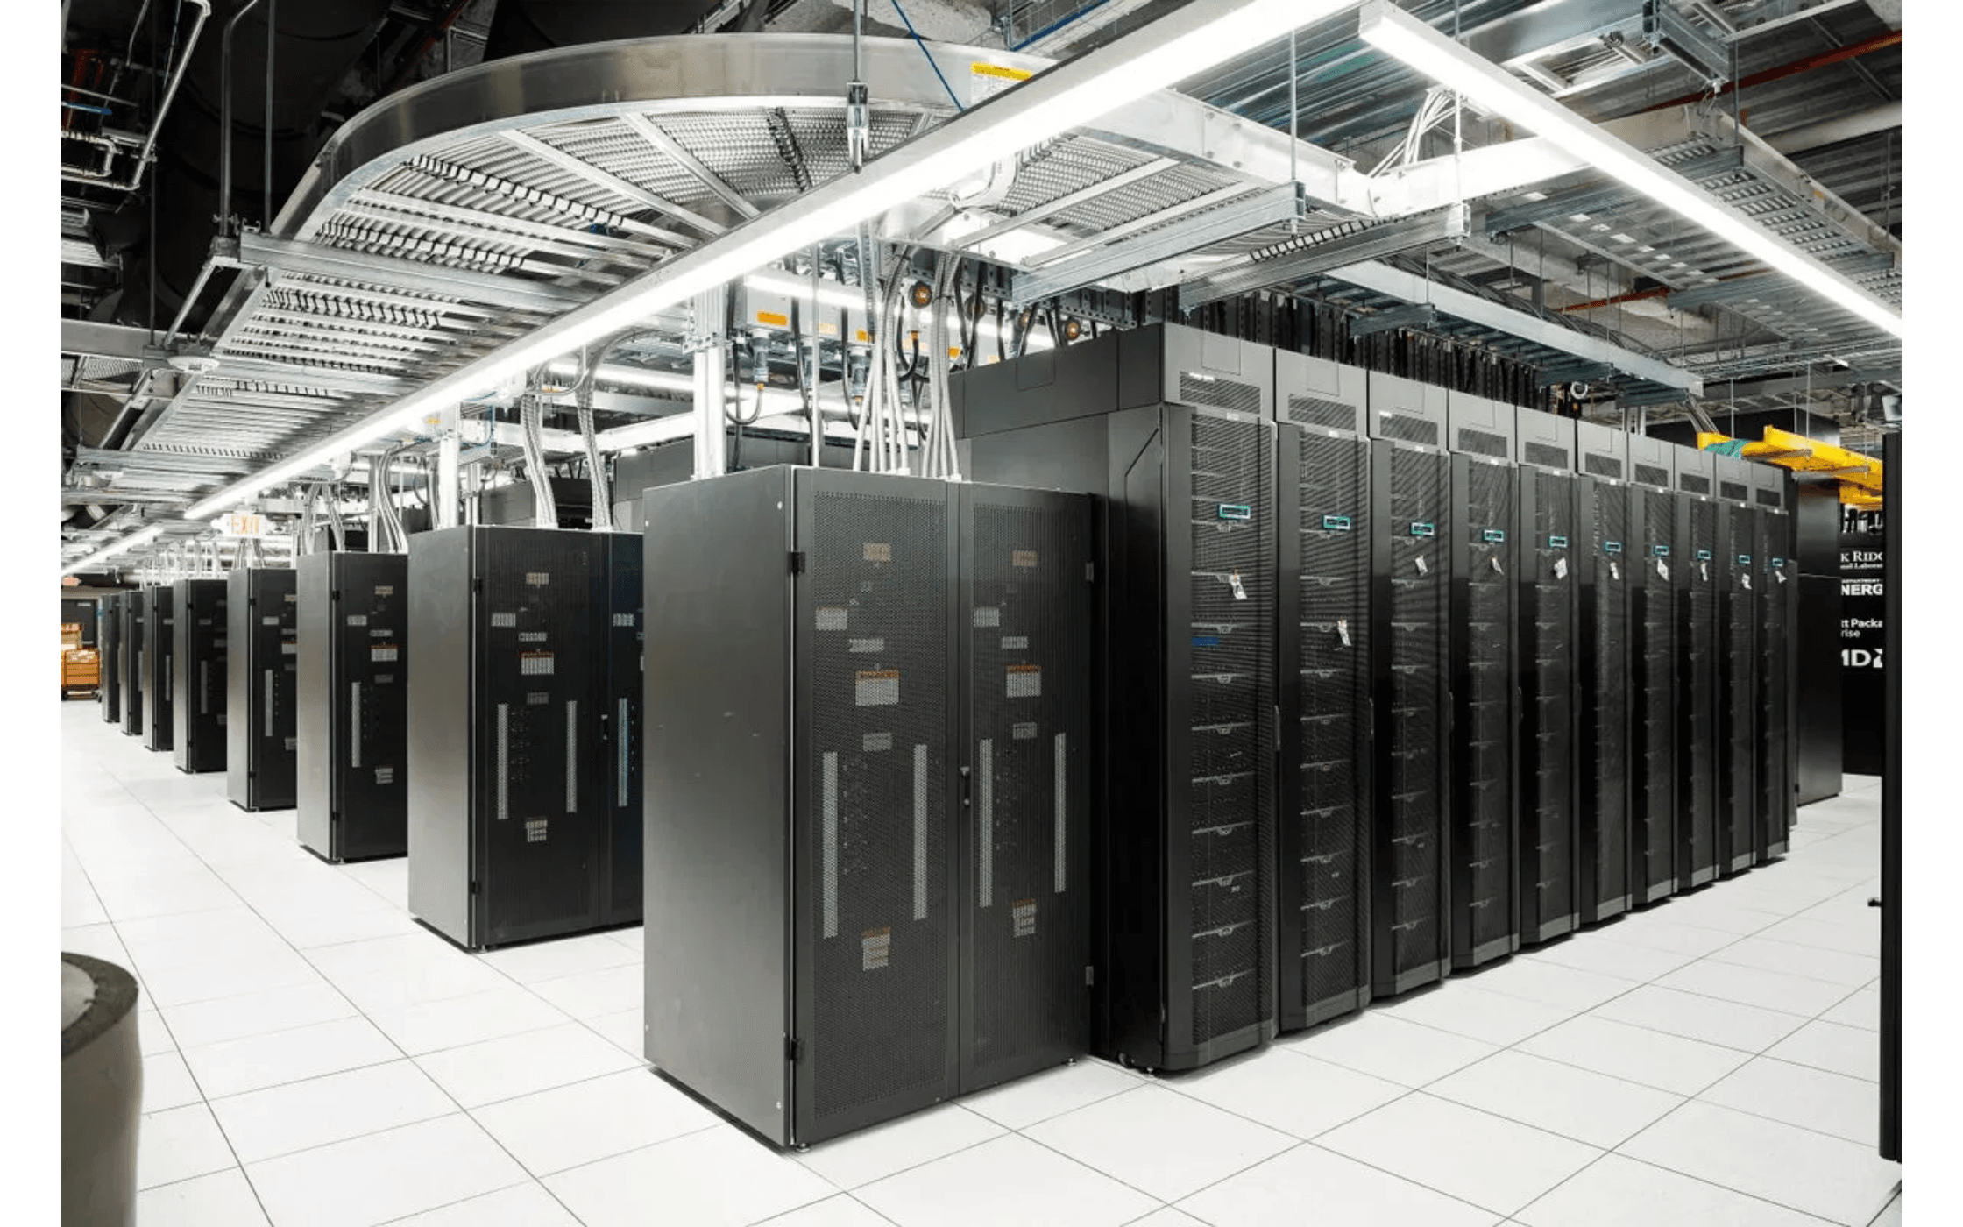
Computing Science as the Third Paradigm of Scientific Discovery
The Traditional Pillars:
Scientific discovery historically relied on
Empirical Observation
and
Theoretical Deduction
.
The New Pillar:
Computational Science
Computing Science introduces the
paradigm.
Computing science has transcended its traditional boundaries to become an indispensable tool and methodology across all scientific disciplines. From astrophysics to zoology, computational approaches are now integral to advancing understanding, conducting experiments, and solving complex problems that were once intractable.

Slide 3

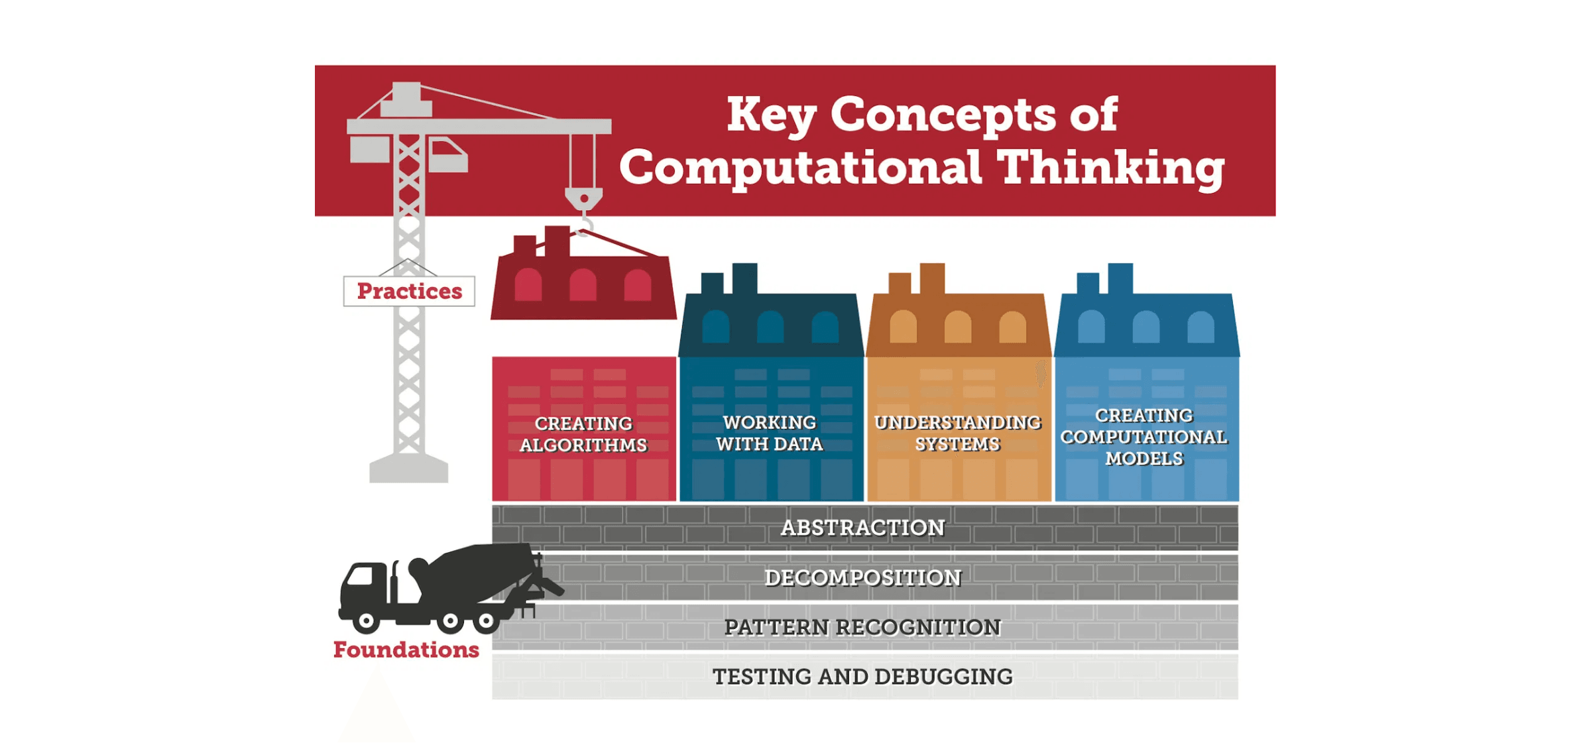
Why Computational Thinking is Essential for Modern Science Education
Data Volume
Modeling
Problem-Solving
Modern scientific instruments generate vast,
Need for sophisticated models and
CT provides mental tools to tackle complex,
complex datasets (Big Data).
simulations to predict and explain
open-ended scientific challenges.
phenomena.
Computational Thinking is no longer an optional skill but a fundamental literacy for scientific inquiry.

Slide 4

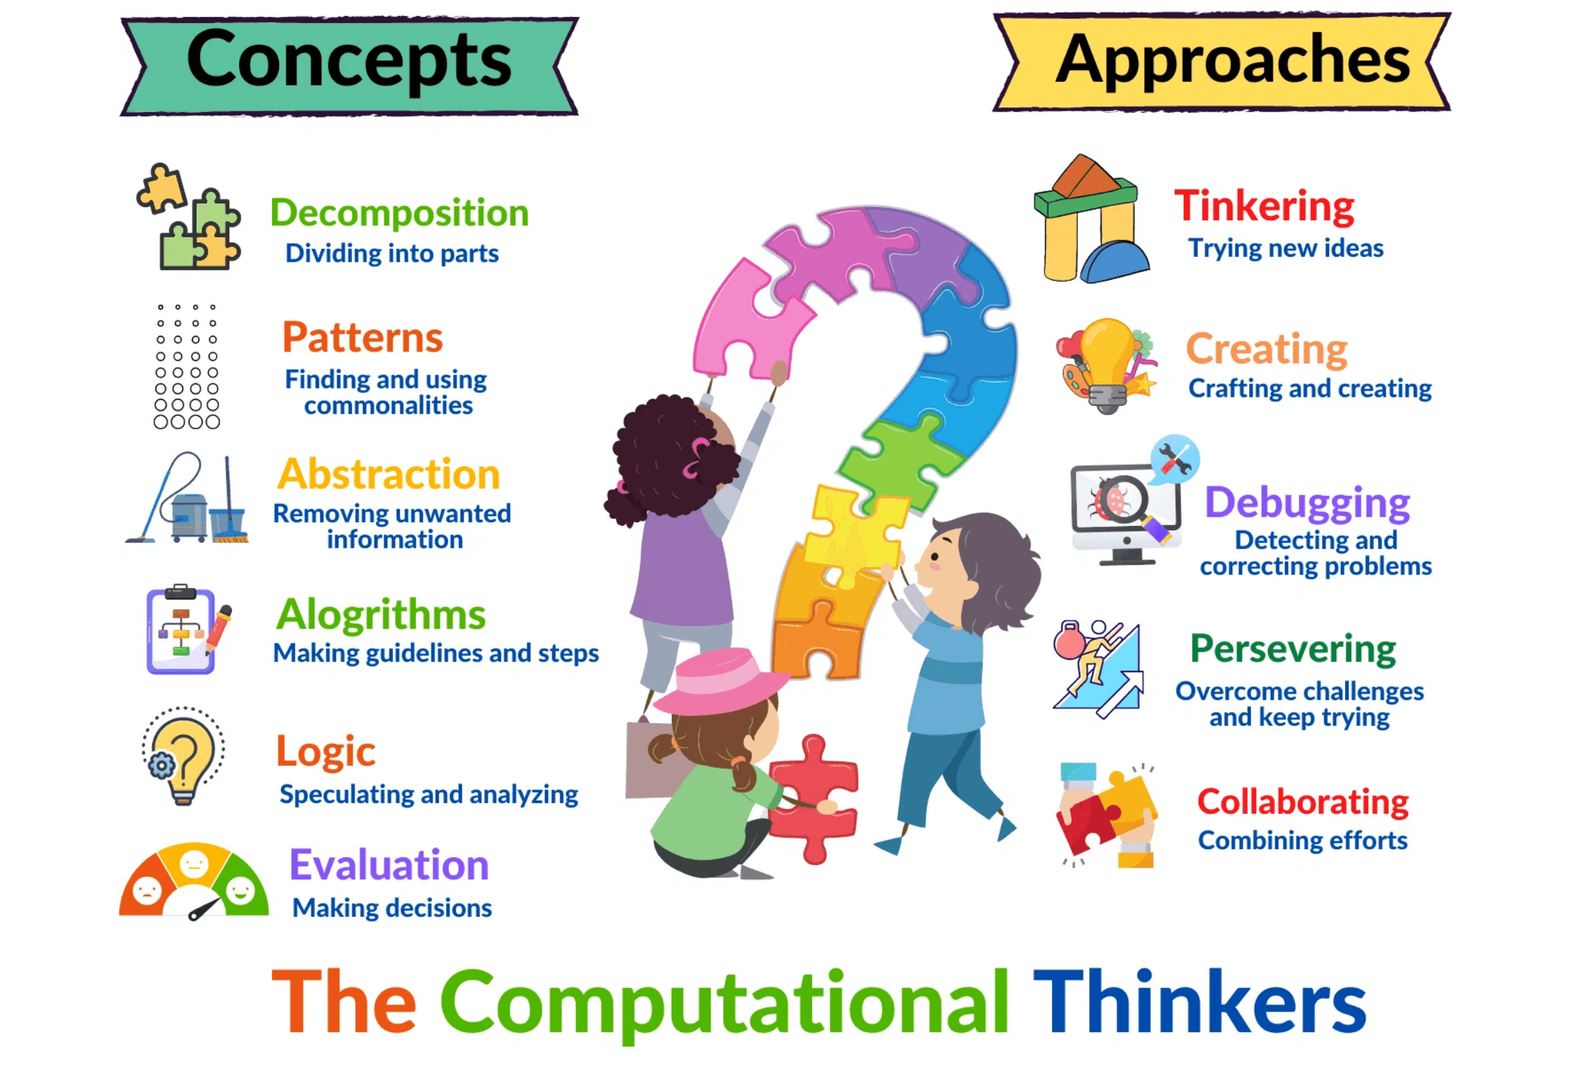
Deconstructing Computational Thinking: A Set of Mental Tools
Definition: Computational Thinking is the thought process involved in formulating a problem and expressing its solution in a way that a computer (human or machine) can effectively carry out.
The Four Pillars:
Decomposition – Breaking problems into smaller parts
▸
Pattern Recognition – Identifying similarities and trends
▸
Abstraction – Focusing on essential details
▸
Algorithms – Creating step-by-step procedures
▸

Slide 5

Abstraction: Focusing on the Essential Scientific Details
Decomposition
Abstraction
Breaking down a complex scientific problem into smaller, manageable sub-problems.
Identifying the core, essential information while filtering out irrelevant details to create a simplified model or representation.
Example: Breaking down climate change into atmospheric, oceanic, and terrestrial subsystems.
Example: Creating a simplified model of a complex ecosystem focusing only on predator-prey relationships.
Application in Science
Decomposition and abstraction are fundamental to scientific modeling. When studying a complex ecosystem, scientists decompose it into individual organisms and their interactions, then abstract away unnecessary details to create a manageable mathematical or computational model. This allows researchers to understand the system's behavior and make predictions about future states.
These mental tools enable scientists to tackle problems that would otherwise be too complex to understand or solve.

Slide 6

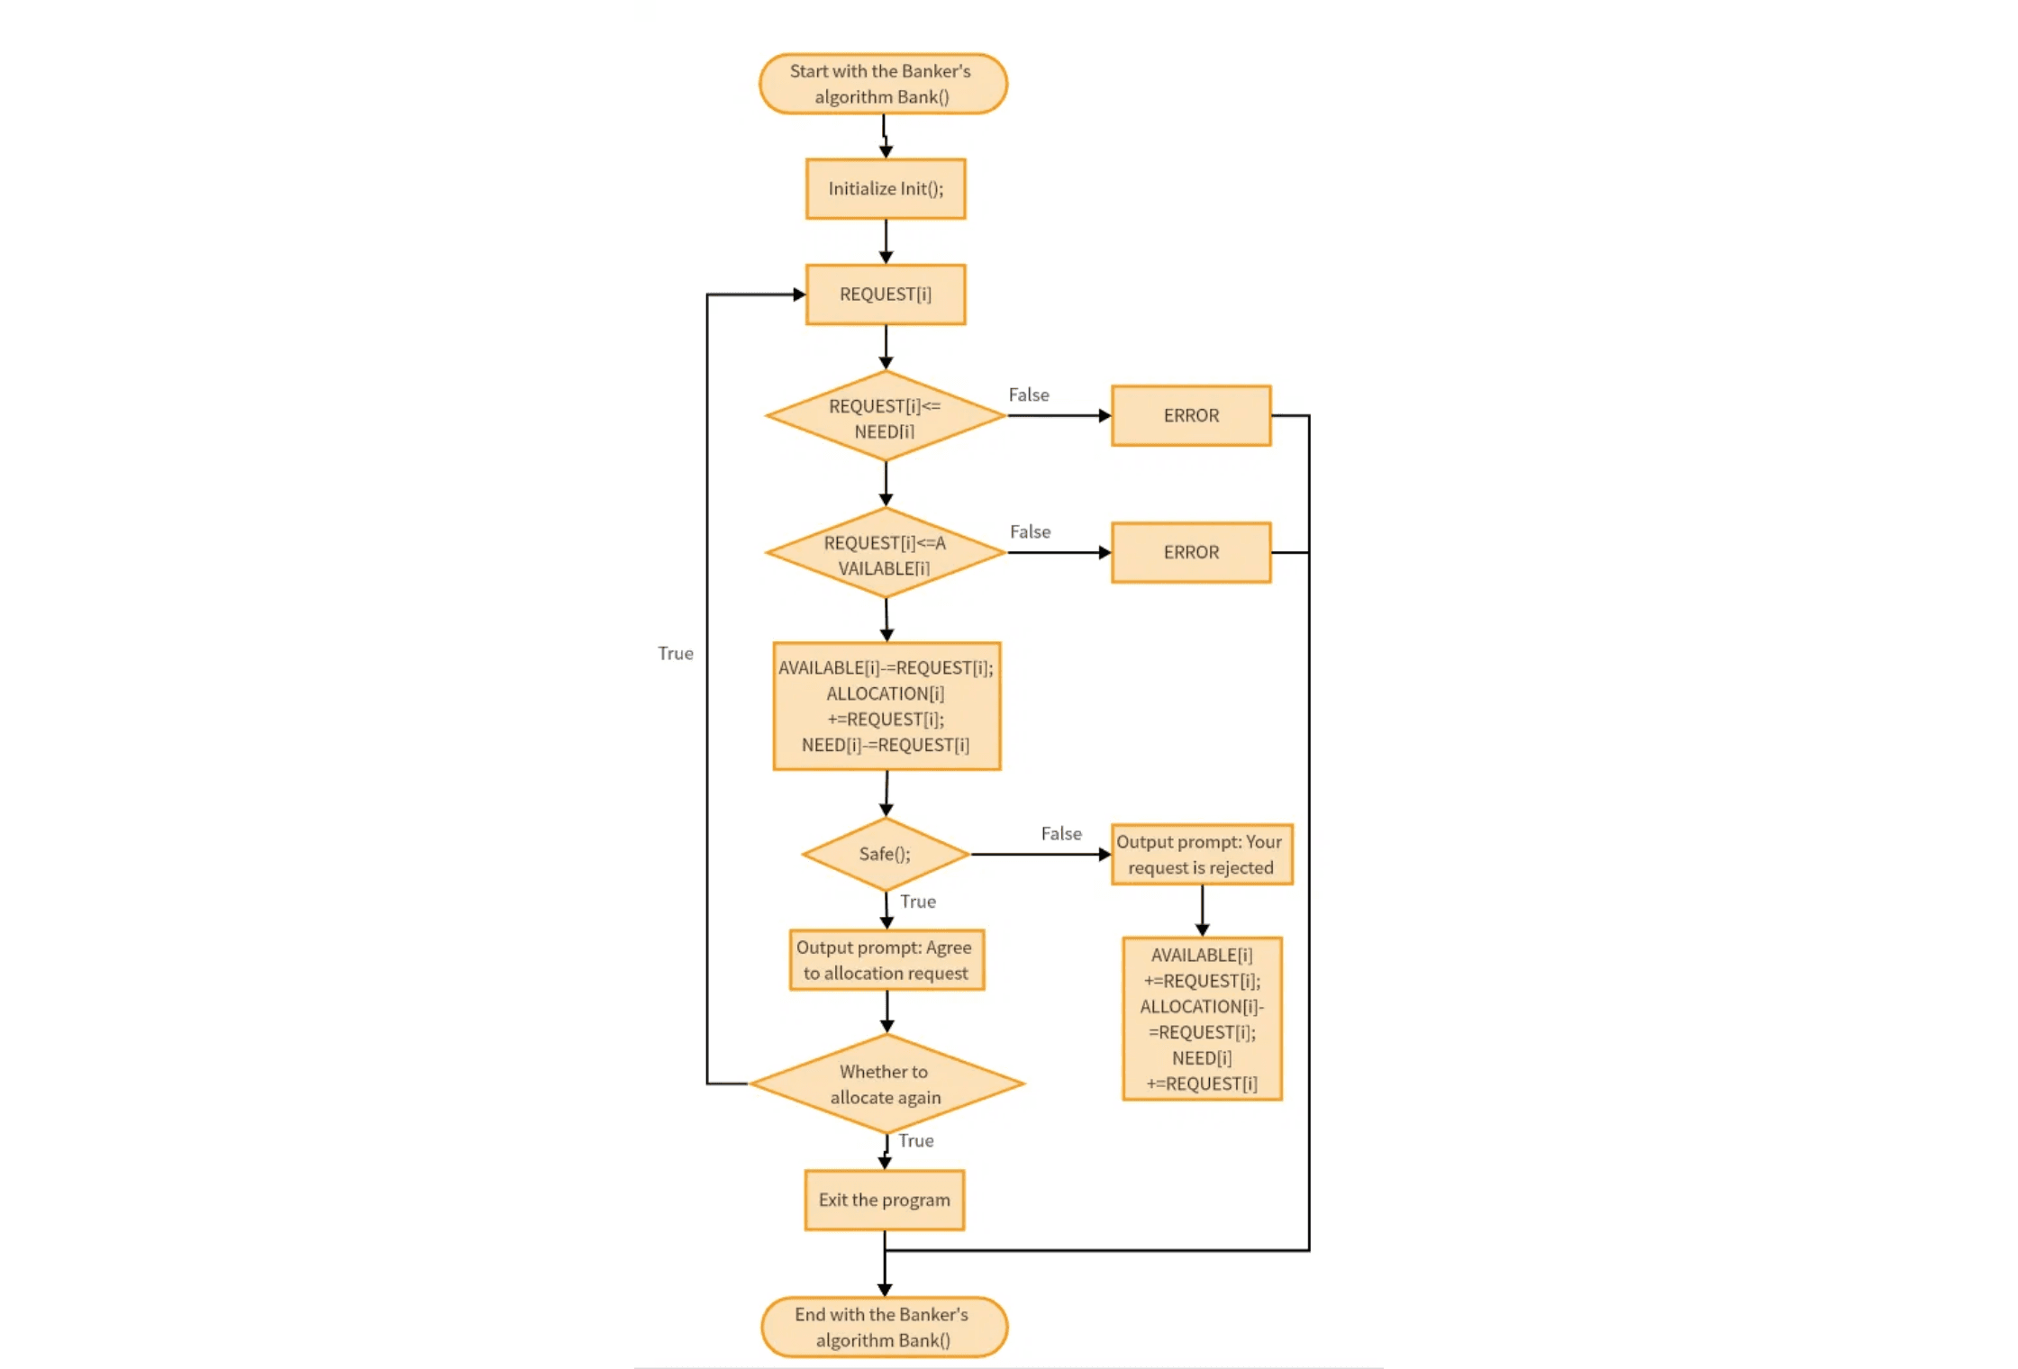
Algorithms: The Logic of Scientific Procedure
Pattern Recognition
Identifying similarities, trends, or recurring themes in scientific data or processes. This foundational skill enables scientists to recognize patterns that might otherwise go unnoticed.
Algorithms
Developing a step-by-step procedure or set of rules to solve a problem or achieve a scientific goal. Algorithms transform abstract concepts into concrete, executable processes.
Application in Science
Designing a repeatable experimental protocol or a flow chart for diagnosing a system failure. These algorithmic approaches ensure consistency and reproducibility in scientific work.

Slide 7

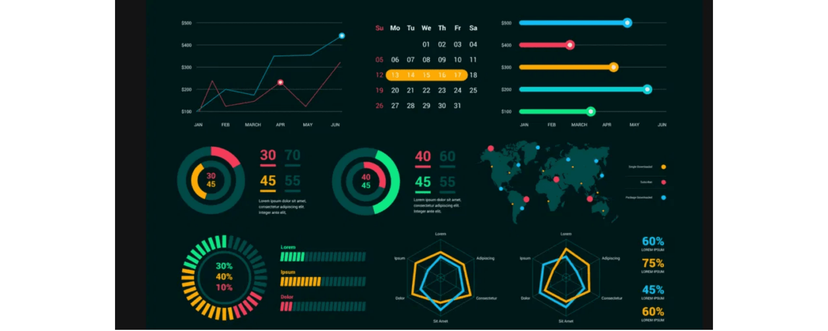
The Centrality of Data in Computational Science
Data Collection
Data Processing
Using digital sensors and tools to gather high-fidelity data from experiments
Cleaning, organizing, and transforming raw data into a usable format for
and observations.
analysis.
Data Visualization
Data Interpretation
Using computational tools to represent data visually, revealing patterns and
Drawing meaningful conclusions from visualized data to support scientific
insights.
discovery.
Effective data management is the foundation of modern scientific evidence and discovery.

Slide 8

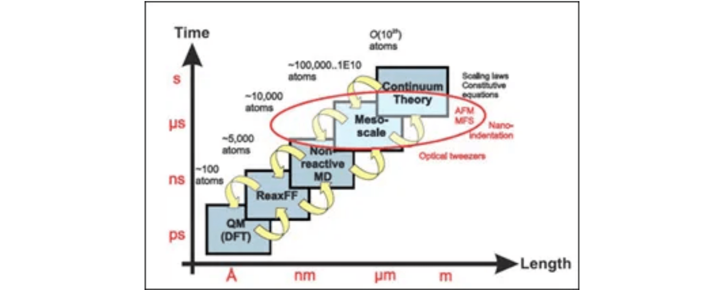
Modeling and Simulation: Predicting and Explaining Scientific Phenomena
Concept 1
Concept 2
Concept 3
Modeling
Simulation
Value
Creating a simplified, abstract representation of a real-world system (e.g., a mathematical equation for population growth).
Running the model over time to observe its behavior and predict outcomes under different conditions (e.g., simulating virus spread).
Allows scientists to test hypotheses and explore scenarios that are too dangerous, expensive, or time-consuming to conduct in a real lab.
Computational modeling and simulation are essential tools for modern scientific discovery and prediction.

Slide 9

Integrating CT into Science: The CT-S Framework
Goal: A pedagogical framework designed to explicitly link CT practices with established scientific inquiry practices, moving beyond using computers as mere tools to teaching students to think computationally about science.
CT Practices
Science Practices
Integration Focus
•
Data Practices
•
Asking Questions
•
Computational Fluency
Collecting, organizing, and analyzing data
Formulating scientific inquiry
Students think computationally about science
computationally
•
Developing Models
•
Authentic Application
•
Modeling & Simulation
Creating scientific representations
Real-world scientific problems
Creating and testing computational models
•
Analyzing Data
•
Conceptual Understanding
•
Problem Solving
Drawing evidence-based conclusions
Deep learning through integration
Using algorithms to solve complex problems
The CT-S Framework transforms science education by making computational thinking an integral part of scientific inquiry, not an add-on.

Slide 10

Empowering the Next Generation of Science Educators
Benefit 1
Benefit 2
Benefit 3
Benefit 4
Enhanced Pedagogy
Curriculum Relevance
Student Engagement
Professional Growth
CT provides new ways to teach complex scientific concepts through interactive models and data exploration, making abstract ideas concrete and engaging.
Ensures the science curriculum is aligned with contemporary scientific research and industry practices, preparing students for future careers.
Increases student motivation by connecting abstract concepts to real-world, computational applications and authentic scientific problems.
Equips teachers with the skills needed to navigate and utilize emerging educational technologies and computational tools in the classroom.
By integrating computational thinking into science education, teachers empower students to become not just scientifically literate, but computationally fluent and ethically aware citizens.

Slide 11

Chapter 1 Takeaways: A Foundation for the Future
Takeaway 1
Takeaway 2
Computing as the Third Pillar
Computational Thinking as Essential Skill
Computing Science has emerged as the third paradigm of scientific discovery, complementing empirical observation and theoretical deduction. It is now integral to advancing understanding across all scientific disciplines.
Computational Thinking is no longer an optional skill but a fundamental literacy for scientific inquiry. It provides the mental tools needed to tackle complex, data-rich scientific challenges.
Takeaway 3
Takeaway 4
Core Concepts in Action
CT-S Framework for Integration
The four pillars of CT—Abstraction, Algorithms, Data Management, and Modeling—are directly applicable to scientific inquiry and provide practical tools for solving real-world problems.
The CT-Science Framework provides a pedagogical roadmap for explicitly integrating computational thinking with scientific inquiry practices, transforming how science is taught and learned.
These foundational concepts prepare educators and students to navigate the computational demands of modern science and contribute meaningfully to scientific discovery.

Slide 12

Looking Ahead: The Journey to Computational Fluency
Next Chapter Preview
Chapter 2: Computational Thinking: Decomposition and Abstraction
In the next chapter, we will delve deeper into the foundational concepts of decomposition and abstraction with practical examples and classroom applications. You will learn how to design lessons that help students break down complex problems and identify essential patterns in scientific phenomena.
Your Action Items
Begin to identify opportunities in your current science lessons where a computational approach could enhance student understanding and engagement. Consider how data collection, modeling, or algorithmic thinking might transform your teaching practice.
CHEWA THASSANA
Center for AI Powered Digital AgriPhysics Research
Thank You

